Slide 1
Data Visualisation
Statistical Graphics 2

Slide 2
Graphical Excellence Principles
The communication of complex ideas with clarity, precision and efficiency
The viewer can visualise the greatest number of ideas in the shortest time with the least ink in the smallest space
Excellent graphics tend to be multivariate (many variables)
Tells the truth about data.

Slide 3
Graphical Integrity
Assumptions (1930 to 1970):
Audience were easily duped
Statistics is boring.
This led to:
Over embellished graphics
Too much of an emphasis on finding the lies in the data.
John Tukey (late 1960’s):
The emphasis moved from “Showing the obvious to the ignorant” (Tufte, 2001) to creating graphics for statistical analysis of complex data.

Slide 4
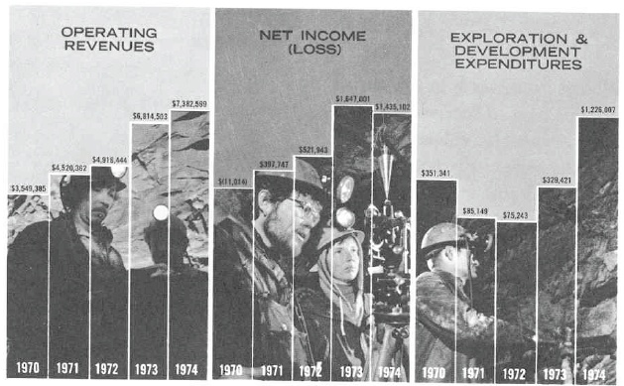
Figure 1 - Example

Slide 5
Problems
Pictures in bars – distracting, humans have evolved to see faces
No scale
Scale not the same
Difficult to compare years

Slide 6
‘Disguising’ a loss

Slide 7
Middle panel: 1970 has a negative income – disguised by having the bars begin at the bottom at approx. minus 4,200,000 dollars.

Slide 8
Graphical Integrity
To maintain a high level of graphical integrity, the graphics should:
Avoid distortion
Remove graphic design variation
Ensure data plotted in time contain units that are standardised appropriately
Ensure data plotted in time contain a sufficiently long time window

Slide 9
1. Avoid Distortion
A graphic does not distort if the visual representation of the data is consistent with the numerical representation.
For example, the theory of psychophysics has established that people perceive changes in areas slower than the actual physical change.
To overcome this problem, the designer of the graphic could use length, which matches actual change with perceived change.
For example a bar chart instead of a pie chart.
Notes:
The theory of psychophysics is built on the term just-noticeable-difference (JND):
The JND is the change in magnitude of a stimulus needed to produce a JND in
sensation. This effect was determined by the German, scientist Ernst Heinrich, to be a
constant.

Slide 10
To Minimise Graphic Distortion..
The representation of numbers, as physically measured on the surface of the graphic should be directly proportional to the numerical quantities represented.
Clear and detailed labelling should be used.

Slide 11
Lie Factor
The effectiveness of the first principle is measured by what Tufte refers to as the lie factor defined as:
Lie Factor = size of effect shown in graphic
size of effect in data
Lie Factor = 1
Indicates an accurate representation.
Lie Factor > 1.05 or LF < 0.95
Indicates a substantial distortion.

Slide 12
Example 1
A newspaper reported that the U.S. Congress and the Department of Transportation had set a series of fuel economy standards to be met by automobile manufacturers, beginning with 18 miles per gallon in 1978 and moving up in steps to 27.5 by 1985, with an increase of 53 percent:
27.5 – 18.0 x 100 = 53%
18.0
Figure 2 shows the accompanying picture published in the New York Times.

Slide 13
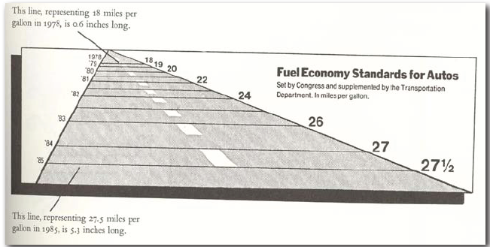
Figure 2 (New York Times, August 1978)

Slide 14
The magnitude of the change from 1978 to 1985 is shown in the graph by the relative lengths of the two lines:
5.3 – 0.6 x 100 = 783%
0.6
Thus the numerical change of 53 percent is presented by some lines that changed 783 percent, giving:
LF = 783 = 14.8
53

Slide 15
Also Perspective
On most roads the future is in front of us, toward the horizon, and the present is at our feet. This display reverses the convention so as to exaggerate the severity of the mileage standards.
The dates on the left remain a constant size on the page even as they move toward the horizon
The values on the right are shrinking as the width of the road shrinks because of change in perspective and change in the actual values - confusing

Slide 16
Example 2
In Figure 3, the size of the barrel is supposed to represent price.
Lie Factor = 9.4
Problem is exacerbated when dealing with three dimensions (psychophysics – differences in perception).

Slide 17
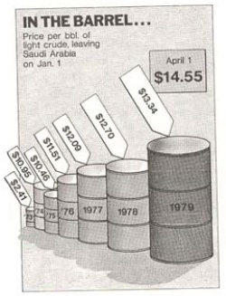
Figure 3

Slide 18
2. Remove Graphic Design Variation
Non uniform changes in a graph are called design variation.
For example, tick marks representing time (e.g. years, months, days) on the x-axis of a graph should be consistent.
That is there should be no variation in the distance between ticks or in the units that the ticks represent.
Design variation of this kind distorts the message of the graph and can lead to ambiguity and confusion to the viewer as the variation of the data is confused (or confounded) with the variation in the design.

Slide 19
Example 1
The line graph in Figure 4 shows that the percentage of materials recycled was increasing from the late eighties. to the late nineties.
It is highest for glass, at 60%, and lowest for plastics and paper (about 10%).
However note that the horizontal scale is not evenly spaced which distorts the graph

Slide 20
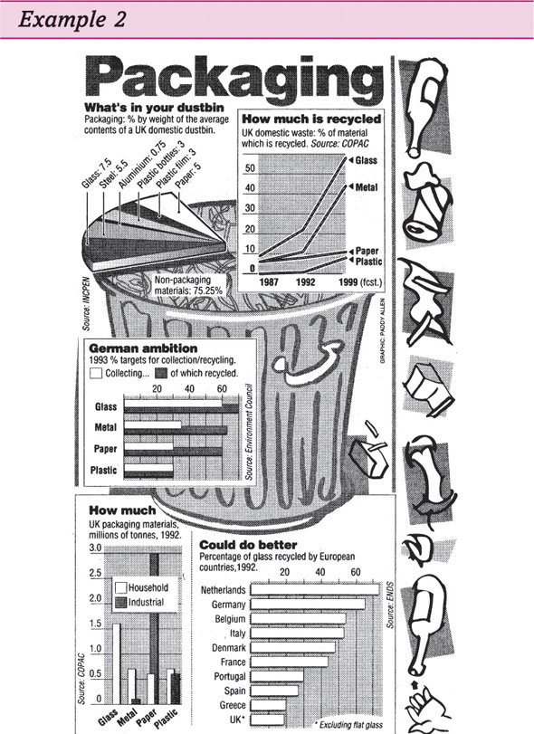
Figure 4

Slide 21
Example 2
Figure 5 is an example of confounding design variation with data variation [Friendly, 2005].
In other words, the scale of the graphic should always correspond to changes in the data being represented [Friendly, 2005].
The graph shown in this example breaks that rule by using area to show one-dimensional data, giving a:
Lie Factor = 2.8 [Friendly, 2005].

Slide 22
Conclusion
The use of two (or three) varying dimensions to show one-dimensional data is not to be recommended.
An inefficient technique
Capable of handling only very small data sets
Ambiguity in perception
Therefore the number of information carrying (variable) dimensions depicted should not exceed the number of dimensions in the data.

Slide 23
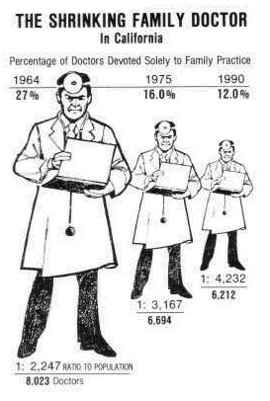
Figure 5
Notes:
Also overlaid perspective and
Incorrect horizontal spacing

Slide 24
3. Plot Time Series Using Standardised Units
Time series that plot financial data should be adjusted for inflation (i.e. discounted) as standardised units of monetary measurement are nearly always better than nominal values.
For non monetary plots, standardised rates are generally preferable than the actual values.

Slide 25
Example
Figure 6 shows that the number of people killed in road accidents in Ireland had remained relatively stable between 1990 and 1999.
However when fatalities are expressed as the standardised rate per million registered vehicles, a sharp decline in the fatal accident rate is apparent over the 10 year period.

Slide 26
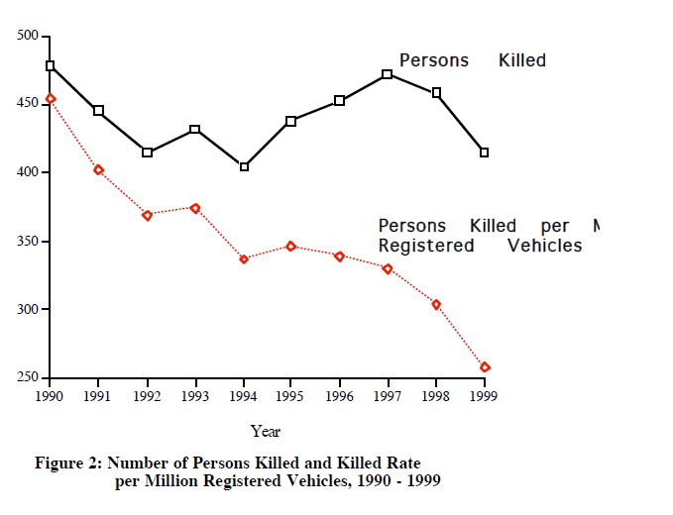
Figure 6
500
Notes:
[Cyril Connolly]

Slide 27
4. Plot Time Series Using a Sufficiently Long Time Window
To be truthful and revealing, data graphics should focus on the question which is at the core of quantitative thinking:
Compared to what?
Staying with Irish road accidents, the media and other road safety organisations have highlighted the road accident in Ireland over the last number of years.
The coverage normally concentrates on the number of, say, fatal accidents in the current month compared with the last number of months or since the start of the year.

Slide 28
For example, in 1999 the number of fatal accidents decreased from 35 in October to 14 in November as shown in Figure 7.
The question that needs to be asked is if this reduction is significant or just part of the random up and down movement (or variability) in accident numbers.
From Figure 7 it is impossible to tell.

Slide 29
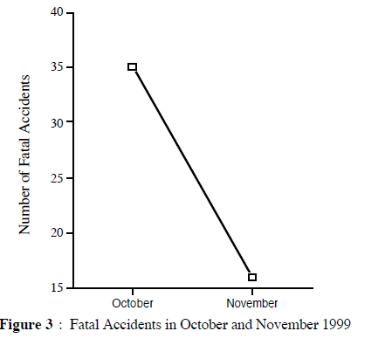
Figure 7
Notes:
[Cyril Connolly]

Slide 30
To overcome this problem a longer time series window is required as shown in Figure 8 which includes three years data by month.
From this plot it is clear that the large change between October and November 1999 is not that unusual.
For example similar large movements can be seen in November/December 1999, and in March/April 1988.

Slide 31
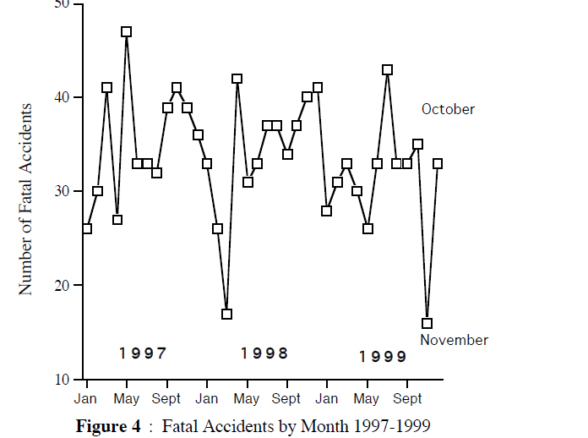
Figure 8
Notes:
[Cyril Connolly]

Slide 32
More Graphical Integrity Examples

Slide 33
Figure 9 – Scale Distortions

Slide 34
Figure 10 – Scale Distortions – Show Entire Scale

Slide 35
Figure 11 - Scale Distortions – Show in Context

Slide 36
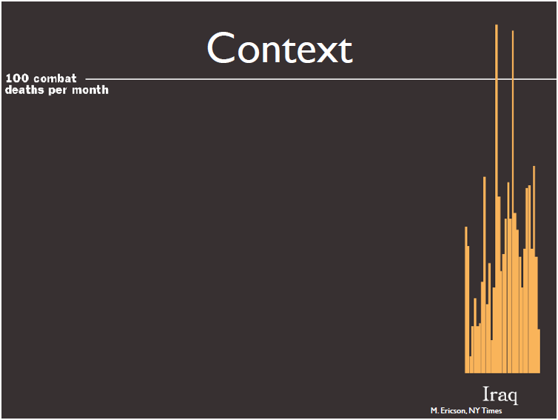
Figure 12 - Context (1)

Slide 37
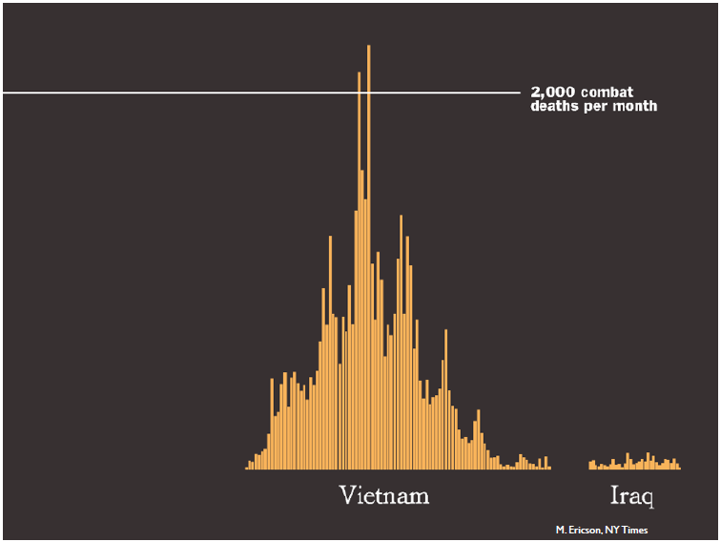
Figure 13 - Context (2)

Slide 38
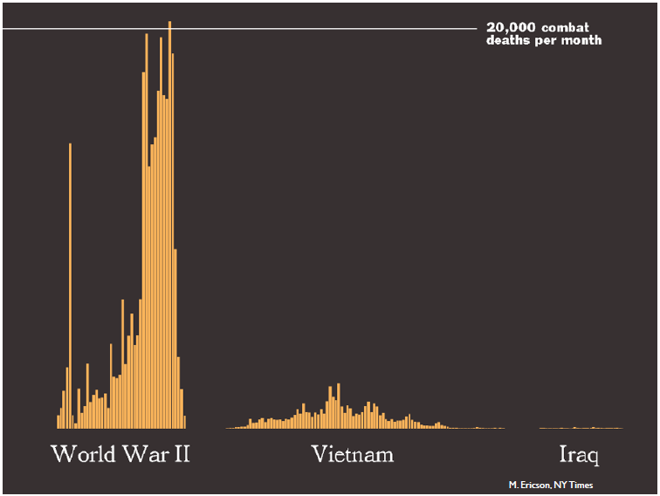
Figure 14 - Context (3)

Slide 39
Graphical Integrity Summary
Don’t lie
Use clear labels to defeat ambiguity and graphical distortion
Show entire scales
Show in context.

Slide 40
Principles of Data Graphics

Slide 41
Data-Ink Ratio
A fundamental principle of good statistical graphics is to show, as far as possible, the data, and remove those parts of the graphic that contain non essential information.
Tufte defines what is known as the data-ink ratio which assess the proportion of a graphics ink devoted to the non redundant display of data information.
The ratio is defined as:
Data-Ink Ratio = Data ink
Total ink used to print the graphic
Or the proportion of a graphic’s ink devoted to the non-redundant display of data information.

Slide 42
If the ratio is one, then this means that no part of a graphic can be erased without loss of some relevant information.
The larger the share of a graphic’s ink devoted to data, the better (other relevant matters being equal).
That is, maximise the data-ink ratio (within reason).

Slide 43
Example 1 (good ratio)
Figure 15 is a time series of the number of serious injury accidents on National Routes by month between 1988 and 1995 (from the 1995 National Roads Authority annual report on road accidents).
The graphic has a data ink ratio close to 1.0.
The only part of the graphic below that can be erased without loss of data information are the axis lines and the tick marks.

Slide 44
Figure 15

Slide 45
The red line is known as a median trend which smooths the data revealing the strong seasonality of serious accidents which are highest during the Summer and lowest during the Winter.
Notes:
Due to holiday traffic

Slide 46
Example 2 (not so good ratio)
Figure 16 has nearly all its ink devoted to non data related matters.
The thick mesh of gridlines overwhelms the numbers (the dots on the graph).

Slide 47
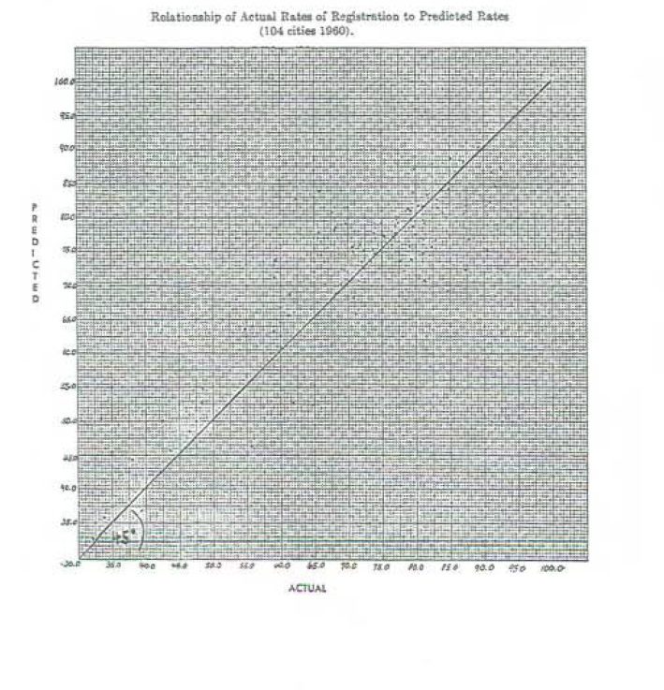
Figure 16

Slide 48
Example 2 (improved)
In a subsequent published version of the same data (Figure 17), the data-ink share was increased to 0.7.

Slide 49
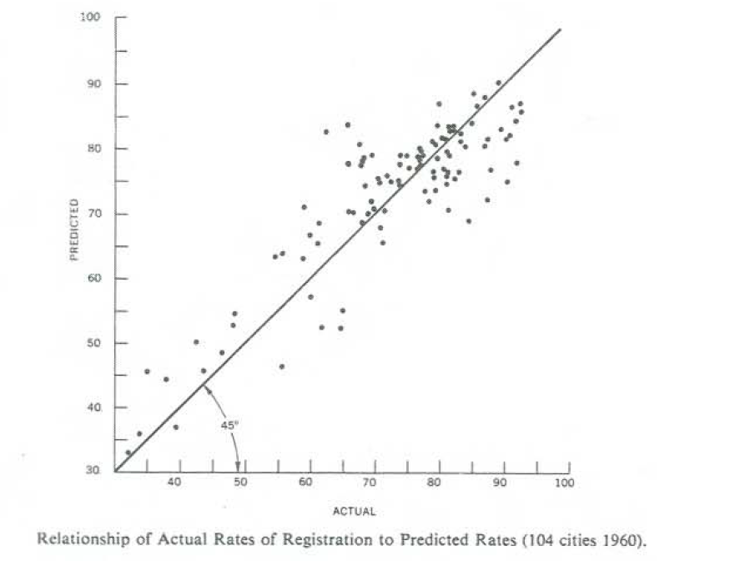
Figure 17

Slide 50
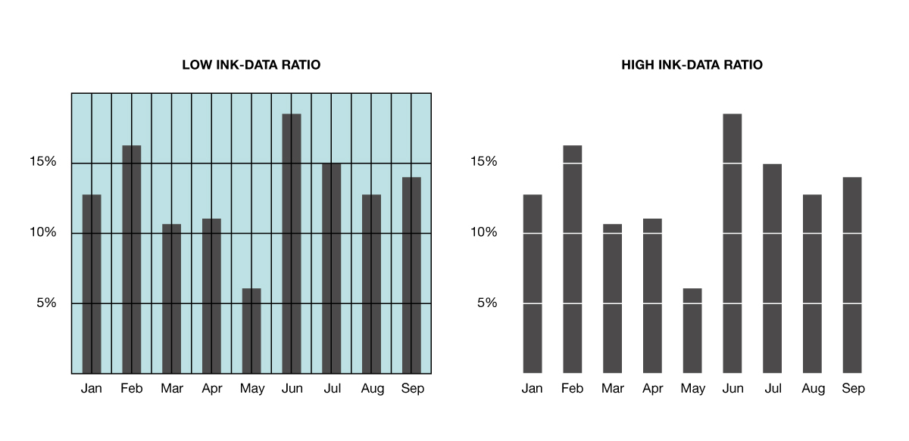
Figure 18 - Example 3

Slide 51
Chartjunk
A related concept known as chartjunk was also devised by Tufte.
Chartjunk is defined as:
Any extra elements that may distract from the data.
Examples of these elements are:
Moiré shading
Artificial colour
Hard to read fonts
Pseudo-3D
Artificial chart decoration.

Slide 52
In other words, chartjunk is redundant ink.
Moiré shading is one of the most common chartjunk elements particularly in bar charts where it is used to fill the bar components.

Slide 53
Example
Figure 19 shows the number of pedestrians killed by hour of day in Great Britain between 1991 and 1995.
The chart on the right contains no Moiré shading and is easier to read as a result.
Moiré effects are, as Tufte states, ‘undoubtedly eye-catching but they are bad art and bad data graphics’.
Moiré effects involve the design interacting with the physiological tremor of the eye to produce a distracting appearance of vibration and movement (Figure 20).

Slide 54
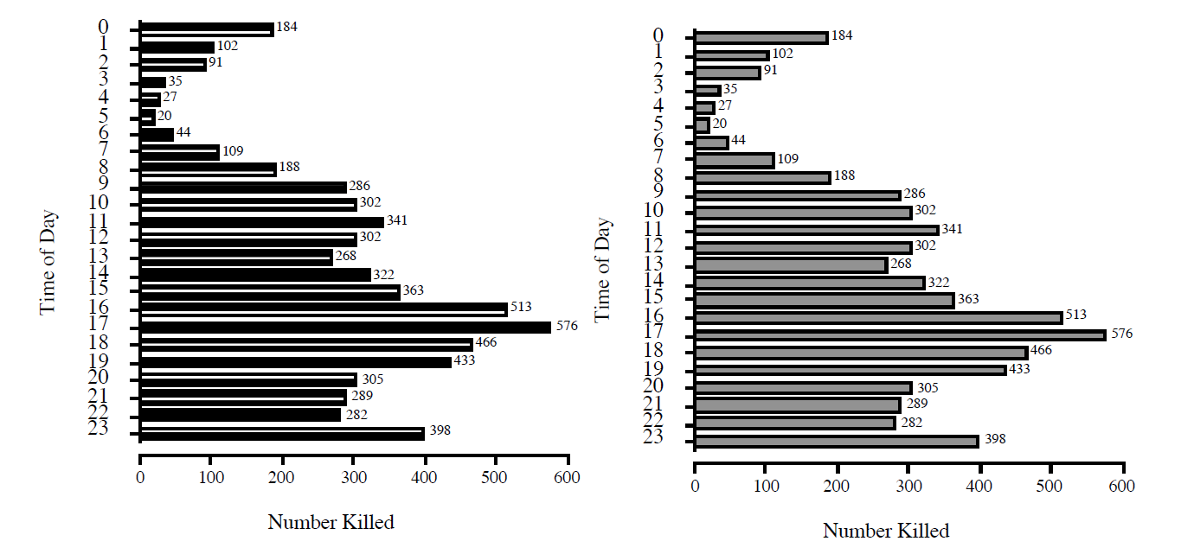
Figure 19
Notes:
[Cyril Connolly]

Slide 55
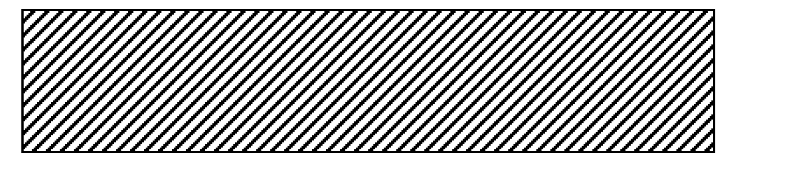
Figure 20

Slide 56
Example
The lip that has been added to make this pie-chart in Figure 21 three dimensional gives a misleading impression.
The eye perceives both the front lip and the segment on top of the pie as a single entity, making the share of the United States seem larger than the others.

Slide 57
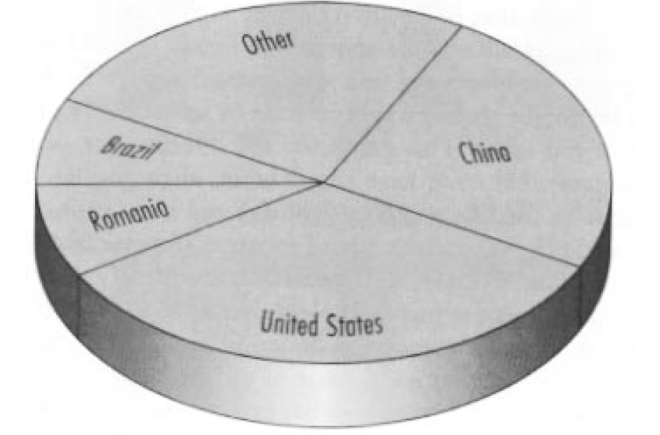
Figure 21 – Maize Production

Slide 58
Erasing and data-ink maximising have induced changes in the bar chart in Figure 22.

Slide 59
Figure 22 - Common Bar Chart 1

Slide 60
Figure 23 - Bar Chart 2
Notes:
Remove grid lines, the box enclosing the graph and the vertical axis except for the ticks

Slide 61
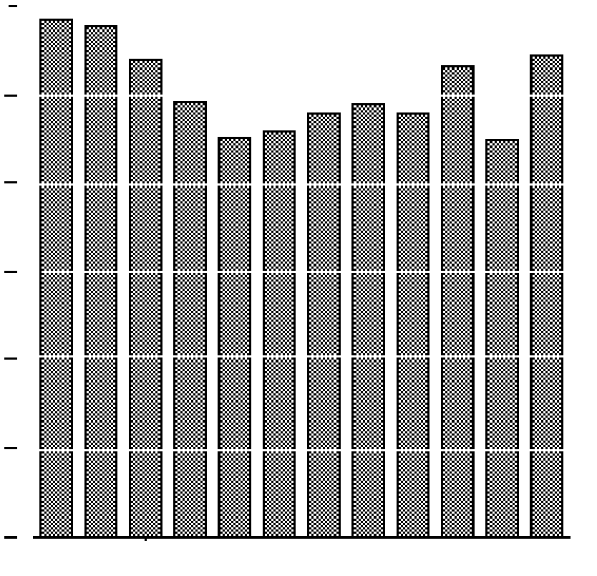
Figure 24 - Bar Chart 3
Notes:
Part of the data measures can be erased making a white grid which shows the coordinate lines more precisely than ticks alone

Slide 62
Figure 25 – Bar Chart 4
Notes:
The white grid removes the need for tick marks

Slide 63
Tufte’s Principes of Data Graphics
Above all else show the data
Maximise the data-ink ratio
Erase non-data ink
Erase redundant data-ink
Revise and edit.

Slide 64
However…
This are principles, not rules that cannot be broken.
“Design is choice. The theory of the visual display of quantitative information consists of principles that generate design options and that guide choices among options. The principles should not be applied rigidly or in a peevish spirit; they are not logically or mathematically certain; and it is better to violate any principle than to place graceless or inelegant marks on paper. Most principles of design should be greeted with some skepticism, for word authority can dominate our vision, and we may come to see only through the lenses of word authority rather than with our own eyes.” (Tufte, 1983)

Slide 65
Task
Find 2 junky charts.
Discuss how they could be improved.

